Slide 1
B.Tech. BCSE497J - Project-I PneuNet: PNEUMONIA DETECTION USING CNN
by 22BDS0269 SWAPNIL DWIVEDI
22BDS0350 ADARSH TIWARI
Under the Supervision of
Prof. Sudhakar P
Assistant Professor Sr. Grade 1
School of Computer Science and Engineering (SCOPE)

Slide 2
Aim of the Project:
The aim of this project is to develop an automated deep learning-based system capable of accurately detecting pneumonia from chest X-ray images. The system integrates a custom CNN model with a fine-tuned ResNet152V2 network using transfer learning, to enhance diagnostic precision, reduce human error, and assist radiologists in making faster and more reliable medical decisions.
Objective:
To design and implement a custom CNN architecture capable of learning spatial and texture features from lung X-ray images.
To preprocess and augment the dataset through normalization, resizing, and augmentation techniques to improve generalization and minimize overfitting.
To evaluate model performance using standard metrics such as accuracy, precision, recall, F1-score, and confusion matrix.
To build an efficient, scalable, and reliable diagnostic tool that supports radiologists and enhances early detection of pneumonia, especially in low-resource medical environments.

Slide 3
Motivation Behind the Project
Radiologist Dependency: Manual interpretation of chest X-rays can vary based on expertise, workload, and fatigue, leading to diagnostic errors.
Bridging Healthcare Gaps: In resource-limited regions, there is a shortage of skilled radiologists — an AI-based detection system can provide quick, accessible diagnoses.
Reducing Human Error: Deep learning offers a consistent and objective approach, minimizing human bias in interpreting X-rays.
Real-Time & Scalable Solution: A CNN-powered model can deliver instant and precise results, supporting telemedicine and mobile-health applications.
Goal: To create a cost-effective, reliable, and automated diagnostic system that assists radiologists and improves patient outcomes through early detection.

Slide 4
Literature Survey and Gaps Identified
Literature Survey 1
Paper: L. Gowri, “Enhancing Pneumonia Detection with Masked Neural Networks,” Neural Computing and Applications, 2024.
What They Have Done: Gowri introduced a masked CNN that focuses on the lung region to reduce background interference, improving interpretability and training efficiency.
Gaps Identified:
Limited dataset reduced generalization capacity.
No transfer learning or deeper model comparison was performed.
The model lacked robust augmentation and fine-tuning for performance optimization.
Addressed in Our Work: Our project combines custom CNN with ResNet152V2 and uses class balance, fine-tuning, and residual-SE integration, achieving higher validation and test accuracy while improving generalization across datasets.

Slide 5
Literature Survey 2
Paper: “Pneumonia Disease Detection Using Chest X-Rays and Machine Learning,” Algorithms, Vol. 18, No. 2, 2025. MDPI What They Have Done: This study evaluated a CNN model on original data and subsets with augmentation. For the original dataset the accuracy was around 79%, precision ~76%, recall ~73%, F1-score ~74%, and AUC ~0.85. When dataset size was reduced the performance further dropped (accuracy ~75%, AUC ~0.78). MDPI Gaps Identified:
The poor performance highlights issues of small or imbalanced datasets and limited feature learning capability.
The study did not leverage transfer learning or fine-tuning of deeper models, which could improve generalization.
Channel attention and residual connections were absent, which restrict the model’s ability to learn nuanced infection features. How Our Work Addresses: Our project uses a hybrid of custom CNN (with deeper architecture + attention) and a pretrained ResNet152V2 (fine-tuned). We also apply robust data augmentation, segmentation/attention and training strategies to address dataset-size and learning limitations.

Slide 6
Problem Formulation
Problem Statement:
Pneumonia diagnosis through chest X-rays is a critical yet time-consuming process that heavily depends on expert radiologists. Manual interpretation can lead to delays, misdiagnosis, and inconsistent results, especially in resource-limited healthcare settings.
Key Challenges:
Visual symptoms of pneumonia are subtle and overlapping with other lung diseases.
Existing CNN models struggle to generalize across different datasets and image qualities.
Lack of optimized architectures that balance accuracy and computational efficiency.
Minimal focus on feature-level fusion between custom CNNs and pretrained networks.
Goal:
To formulate and develop a deep learning framework consisting of a Custom CNN and ResNet152V2 for accurate, robust, and automated pneumonia detection from chest X-rays.

Slide 7
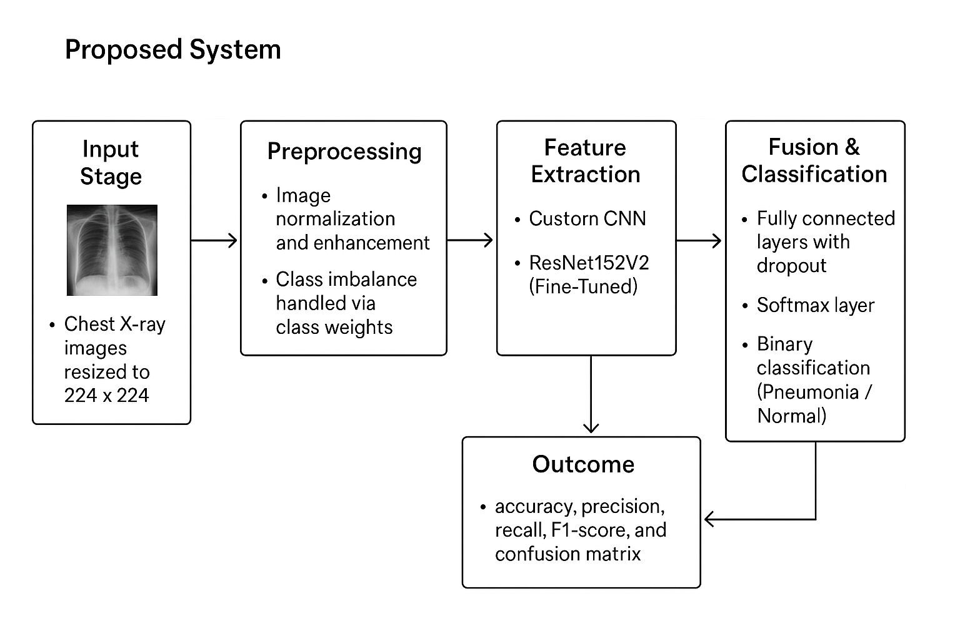
Proposed System Architecture
Overview: An automated deep learning pipeline for pneumonia detection from chest X-rays, combining a Custom CNN and a fine-tuned ResNet152V2. Class imbalance is handled using class weights, ensuring fair learning across categories.
Workflow:
Input Stage: Chest X-ray images are collected and resized to 224×224 pixels.
Preprocessing:
Image normalization and enhancement for consistent brightness and contrast.
Class imbalance handled via class weights during training.
Feature Extraction:
Custom CNN: Captures spatial and texture features of pneumonia-affected lung regions.
ResNet152V2 (Fine-Tuned): Extracts deep hierarchical features and refines pneumonia-specific patterns.
Fusion & Classification: Combined features pass through fully connected layers with dropout, followed by a Softmax layer for binary classification (Pneumonia / Normal).
Evaluation: Model performance is measured using accuracy, precision, recall, F1-score, and confusion matrix.
Outcome: A hybrid, class-balanced deep learning system providing accurate, efficient, and reliable pneumonia detection, suitable for clinical decision support.

Slide 8
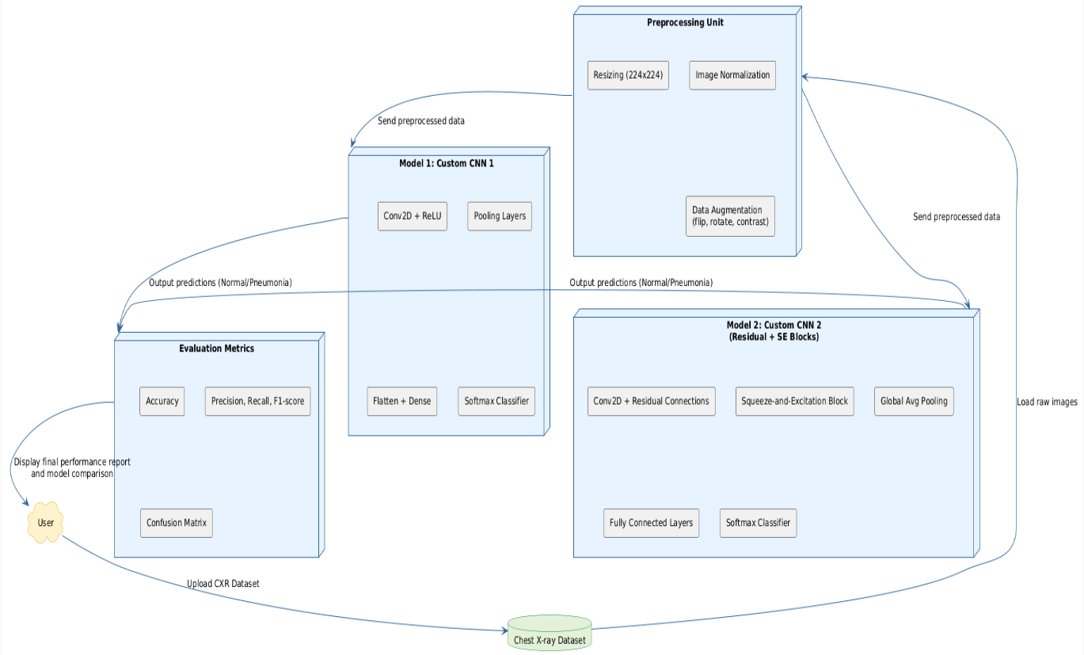
Data Flow Diagram of Custom CNNs
The diagram shows the workflow for pneumonia detection using two CNN architectures — Custom CNN1 and Custom CNN 2 (Residual + SE Blocks).
Chest X-ray Dataset is uploaded and sent to the Preprocessing Unit for:
Resizing (224×224), Normalization, and Data Augmentation.
Preprocessed data is used by both models for training and prediction.
Custom CNN 1: Conv2D + ReLU, Pooling, Flatten, and Softmax classifier.
Custom CNN 2: Residual connections, SE blocks, Global Avg Pooling, and Softmax classifier.
Evaluation Metrics: Accuracy, Precision, Recall, F1-score, and Confusion Matrix.
User receives the final performance report and model comparison.

Slide 9
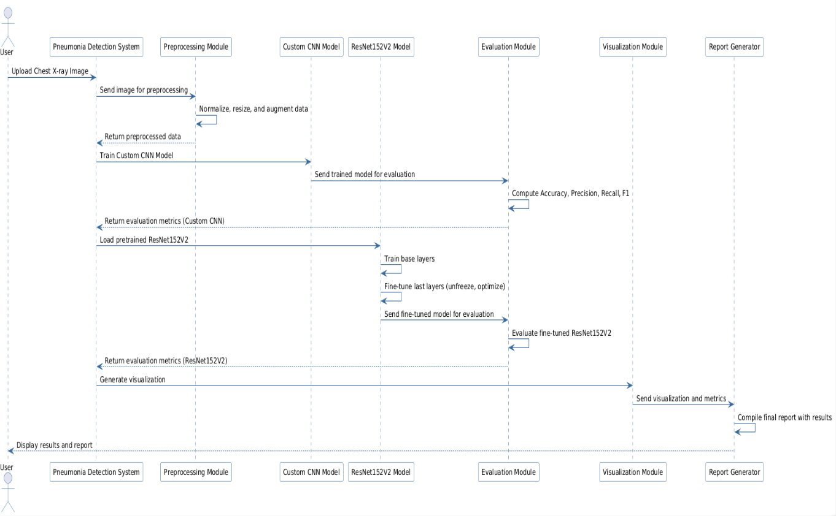
Sequence Overview of Pneumonia Detection System
User uploads Chest X-ray image.
Preprocessing Module resizes, normalizes, and augments the image.
Custom CNN Model is trained using preprocessed data.
Evaluation Module computes Accuracy, Precision, Recall, and F1-score.
ResNet152V2 Model is loaded, base layers trained, and last layers fine-tuned.
Fine-tuned ResNet152V2 is evaluated for performance.
Visualization Module generates comparative results.
Report Generator compiles the final performance report for the User.

Slide 10
Experimental Setup
Environment: Python, TensorFlow/Keras, GPU-enabled Colab/Local machine
Models Evaluated:
Custom CNNs
ResNet152V2
Dataset Split:
Training: Normal-1341;Pneumonia-3875
Testing: Normal-234; Pneumonia-390
Validation: Normal-8; Pneumonia-8
Preprocessing:
Resizing to 224×224
Normalization
Class weights used to handle imbalance

Slide 11
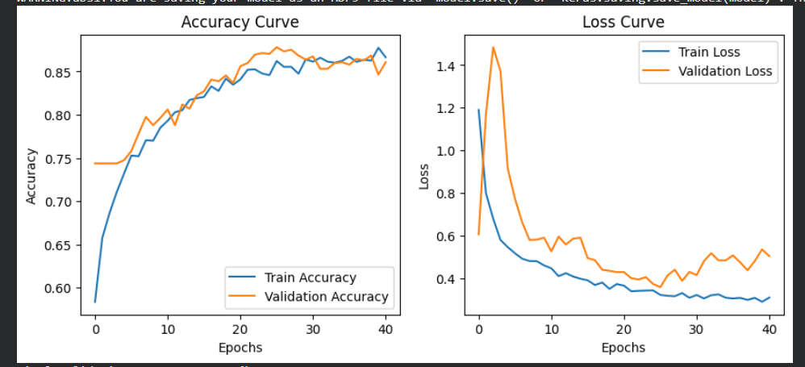
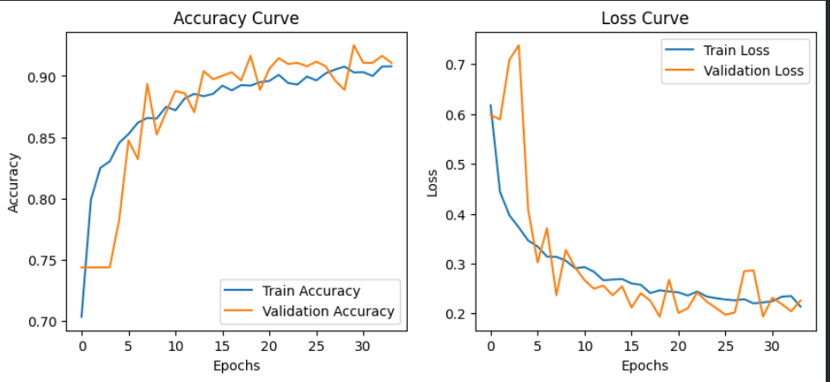
Performance
Comparison of Validation Accuracy Across All Models
Model | Accuracy
Custom CNN | 86.95%
Custom CNN (S&E) | 90.49%
ResNet152V2 | 93.76%
ResNet50 Fine-tuned | 96.06%

Slide 12
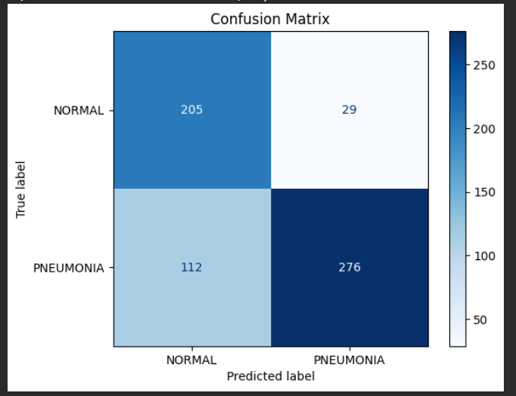
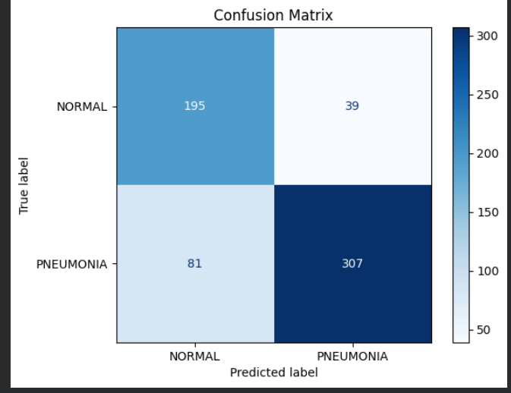
Confusion Matrix Analysis of Custom CNNs
Fig. Confusion Matrix of Custom CNN1
Fig. Confusion Matrix Of Custom CNN2

Slide 13
Results and Observations
Custom CNN 1:
Test accuracy: 77.33% → moderate performance
Validation accuracy: 86.95% → some overfitting
Limited depth and feature extraction capability make it less robust
Custom CNN 2 (Residual + SE Blocks):
Test accuracy: 80.70%, validation: 90.49%
Residual + SE blocks improve feature focus, generalization, and reduce overfitting
ResNet152V2 (Pretrained):
Test accuracy: 90.19%, validation: 93.76%
Pre-trained weights provide strong feature extraction even without fine-tuning
ResNet152V2 (Fine-Tuned):
Test accuracy: 92.28%, validation: 96.06%
Fine-tuning deeper layers enhances generalization and optimizes pneumonia-specific features

Slide 14
Conclusion:
Fine-tuned ResNet152V2 achieved the highest validation (96.06%) and test accuracy (92.28%), outperforming custom CNN architectures.
Custom CNN 2 (Residual + SE blocks) showed significant improvement over simple CNNs, highlighting the value of residual connections and SE blocks.
Pre-trained models provide strong feature extraction, even without fine-tuning.
Deep learning models are effective for early and accurate pneumonia detection.
Future Development:
Expand to detect other lung diseases such as tuberculosis, COVID-19, or lung cancer.
Explore other pre-trained architectures (DenseNet, EfficientNet) for higher accuracy.
Increase dataset size and diversity to improve generalization.
Deploy as a real-time clinical tool integrated with hospital systems.

Slide 15
Outcomes Achieved
Technical Outcomes:
Developed a deep learning-based pneumonia detection system using Custom CNNs and ResNet152V2.
Achieved high accuracy: Fine-tuned ResNet152V2 → 96.06% validation, 92.28% test accuracy.
Implemented advanced architectures (Residual + SE blocks) to improve feature extraction and generalization.
Demonstrated the effectiveness of Squeeze & Excitation and fine-tuning for medical image analysis.
Academic/Knowledge Outcomes:
Gained hands-on experience in deep learning, CNNs, and transfer learning.
Learned data preprocessing, handling class imbalance, and evaluation metrics in medical imaging.
Improved understanding of model optimization, architecture design, and performance analysis.
Enhanced skills in interpreting results and presenting findings in a research-oriented manner.

Slide 16
References- Research Paper
Rajpurkar, P., Irvin, J., Ball, R., Zhu, K., Yang, B., Mehta, H., et al. (2017). CheXNet: Radiologist-Level Pneumonia Detection on Chest X-Rays with Deep Learning. arXiv:1711.05225.
Wang, X., Peng, Y., Lu, L., Lu, Z., Bagheri, M., & Summers, R.M. (2017). ChestX-ray8: Hospital-scale Chest X-ray Database and Benchmarks on Weakly-Supervised Classification and Localization of Common Thorax Diseases. IEEE CVPR.
Rajaraman, S., & Antani, S. (2020). Performance evaluation of deep learning architectures for pneumonia detection in chest X-rays. Computers in Biology and Medicine, 121, 103765.

Slide 17
References – Dataset and Tools
Datasets:
Chest X-Ray Images (Pneumonia) Dataset – Kaggle (https://www.kaggle.com/paultimothymooney/chest-xray-pneumonia)
Frameworks & Libraries:
TensorFlow/Keras for model building and training
OpenCV, PIL for image preprocessing
NumPy, Pandas, Matplotlib, Seaborn for data handling and visualization

Slide 18
References- Additionl References nd Techniques
Huang, G., Liu, Z., Van Der Maaten, L., & Weinberger, K.Q. (2017). Densely Connected Convolutional Networks (DenseNet). CVPR.
Hu, J., Shen, L., & Sun, G. (2018). Squeeze-and-Excitation Networks. CVPR.
Shorten, C., & Khoshgoftaar, T.M. (2019). A survey on Image Data Augmentation for Deep Learning. Journal of Big Data, 6(1), 60.

